Slide 1
HNDIT1022 – Web Design
Week 7: understanding dynamic web sites and introduction to photoshop

Slide 2
Subtopics
What are dynamic web sites
Introduction to the photoshop
Resizing &cropping image Photo retouching

Slide 3
What is a STATIC WEBSITE ?
Any Site that has fixed content usually written in html code.
Every page will have the Code written separately, just as you see it on the web.
Every page has to be saved separately on the server.
Changes have to be made manually every time, and you need coding knowledge to make any and all changes.

Slide 4
Advantages & Disadvantages of STATIC Websites
Advantages
Easy to develop
Cheap to develop
Cheap to host
Disadvantages (Cons)
Requires web development expertise to update site
Changes and updates are very time consuming
Site not as useful for the user
Content can get stagnant
OUT OF DATE!!

Slide 5
DYNAMIC WEBSITE
A site whose construction is controlled by an application server processed by server-side scripts. Pages of the website are not coded and saved separately.
The design/template ( look and feel ) is saved separately.
Corresponding content are saved separately.
The pages are dynamically populated every time.

Slide 6
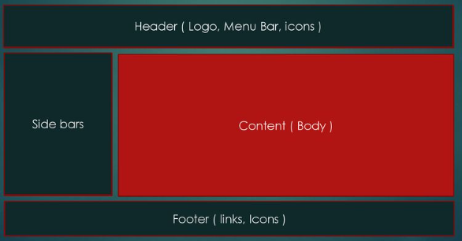
Website Structure

Slide 7
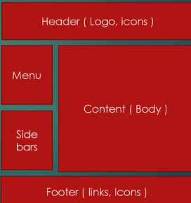
A DYNAMIC Website Structure
A request to view a page will Dynamically populate the different sections of the site according to a template file
Header
Menu
Content
Side bars
Footer

Slide 8
Advantages & Disadvantages of DYNAMIC websites
Advantages
Much more functional website
Much easier to update
Much Easier to add new content/pages
New content brings people back to the site and helps in the search engines
Can work as a system to allow staff or users to collaborate
It provides the attractive look.
It is useful for E-commerce sites.
It provide a clear and the well-organized look.
Disadvantages
More expensive to develop
Slower to develop
Hosting costs a little more ( This might not be true now, because of great shared web hosting plans these days)

Slide 9
Static Website Vs Dynamic Website
Static Website
It is used the HTML code to develop a website.
Flexibility is the important in the static website.
The same content webpage load in the website .
Dynamic Website
It is used the sever side Scripting language .
CMS is the important in the dynamic website.
The content is generate quickly.
CMS-content management system
Notes:
content management system (CMS) is a software application that enables users to create, edit, collaborate on, publish and store digital content.

